Slide 1
Human-Robot Interaction
by Dr. Katrin S. Lohan

Slide 2
What you can expect
State-of-the-art research
An overview over the field of human robot interaction
guideline through the exciting field and young field HRI

Slide 3
What is human-robot interaction?
Human–robot interaction is the study of interactions between humans and robots. It is often referred as HRI by researchers.
Human–robot interaction is a multidisciplinary field with contributions from human–computer interaction, artificial intelligence, robotics, natural language understanding, design, neuroscience, social sciences, biology …

Slide 4
My Background
Developmental/Cognitive Robotics:
studying the developmental mechanisms, architectures and constraints that allow lifelong and open-ended learning of new skills and new knowledge in embodied machines
As in children, learning is expected to be accumulative and of progressively increasing complexity, and to result from self-exploration of the world in combination with social interaction.
Studying social interactions like tutoring situations
where a robot is the learner and derives its knowledge from an untrained (naive) user’s demonstration
Using methodological approaches and theories derived from developmental psychology, neuroscience, developmental and evolutionary biology, and linguistics

Slide 5
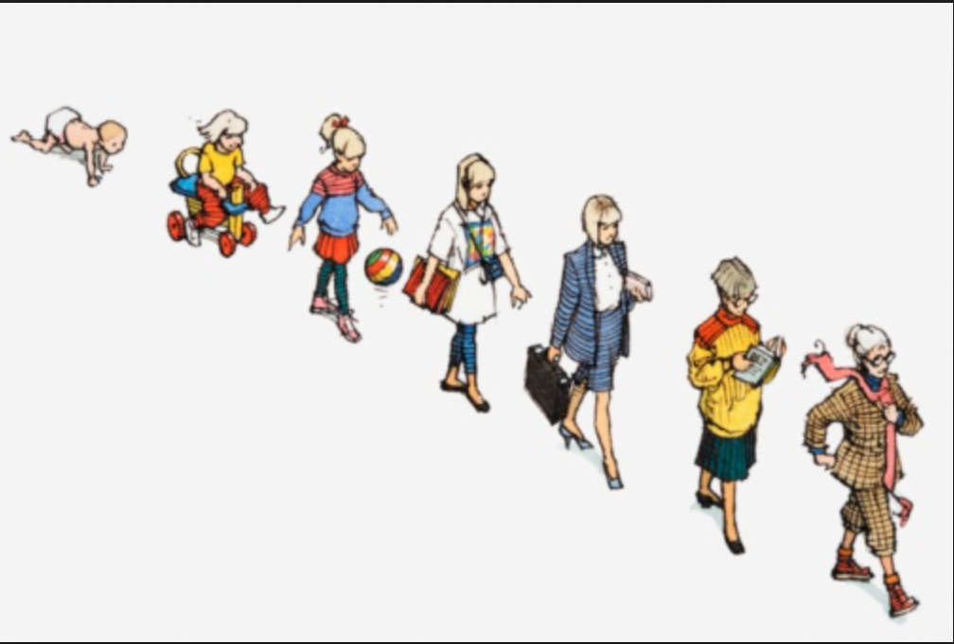
What does the word “Human” refer to in HRI?
The human is seen as
an interaction partner
a caregiver
a source for knowledge
a companion
an assistant
a model
the focus of research
…
in HRI.

Slide 6
What does the word “Human” refer to in HRI?
https://www.youtube.com/watch?v=v8EG17wXxLM

Slide 7
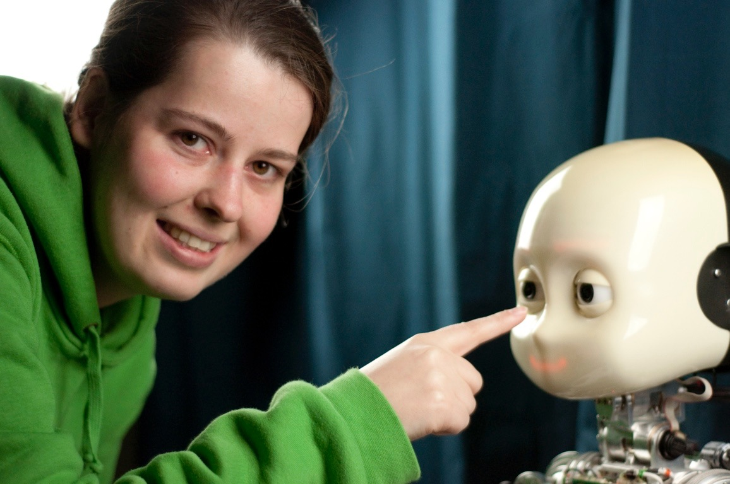
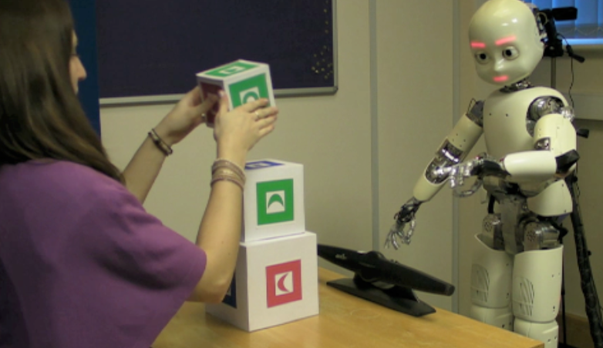
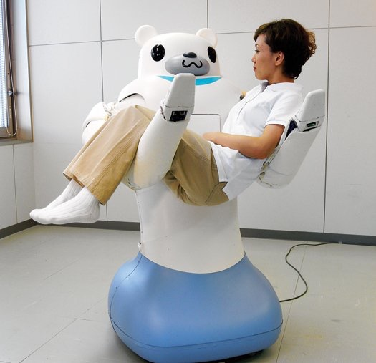
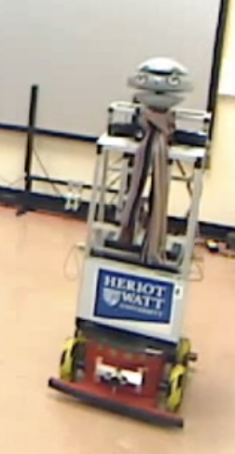
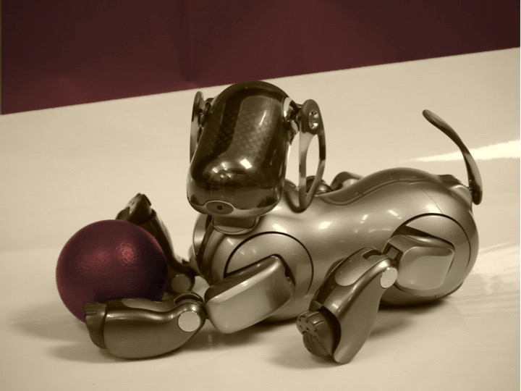
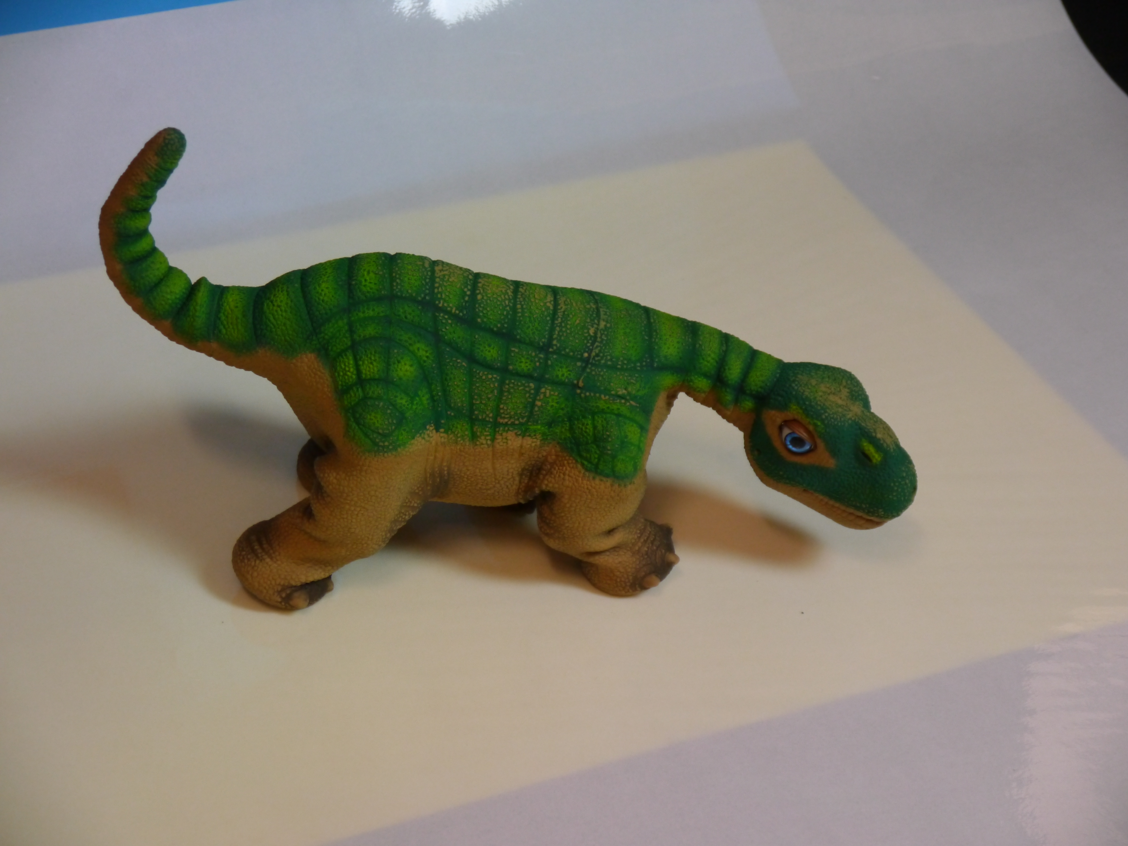
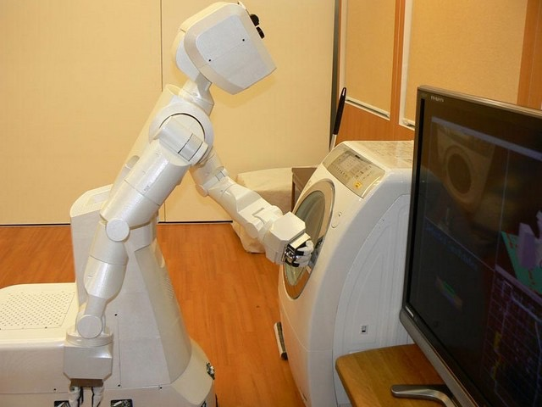
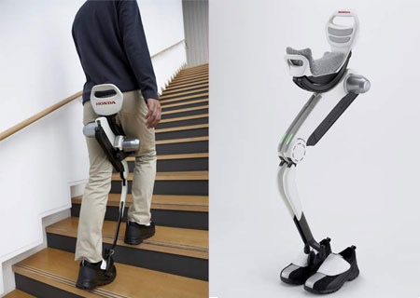

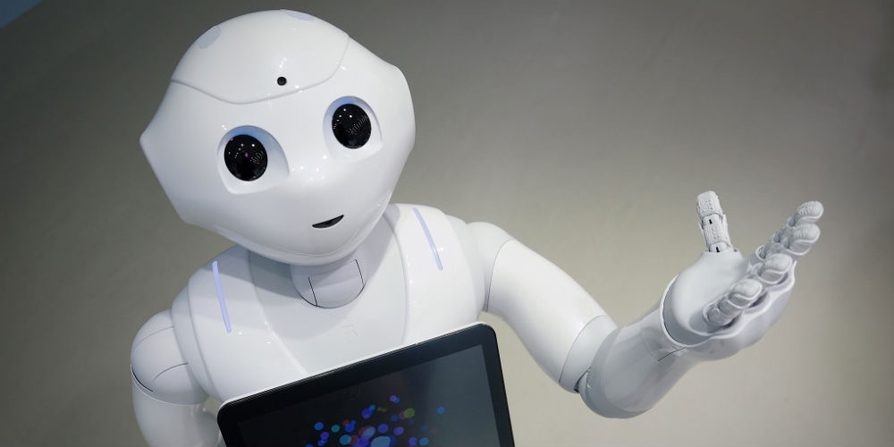
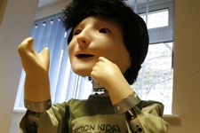
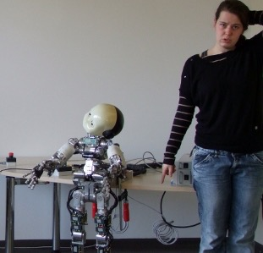
What does the word “Robot” refer to in HRI?
The robot is seen as
an interaction partner
a caregiver
a source for knowledge
a companion
an assistant
a model
the focus of research
…
in HRI.

Slide 8
What dose the word “Robot” refer to in HRI?
https://www.youtube.com/watch?v=ErgfgF0uwUo

Slide 9
What does the word “Interaction” refer to in HRI?
The interaction is seen as
the interplay between human and robot
a knowledge transfer loop
a feedback loop
a question of contingency
the method to programm a robot
…

Slide 10
What does the word “Interaction” refer to in HRI?
https://www.youtube.com/watch?v=AWZxvE5g5Pw

Slide 11
What are the different research discipline in HRI?
they are either focused on studying the human, the robot or the interaction:
social signals
cognitive architecture
computer vision
robotics
manipulation
rehabilitation
machine learning
artificial intelegents
Psychologie
Linguistics / computer linguistics
social cognition
…

Slide 12
Why do we study HRI?
to understand:
human cognition
social communication
and create intelligent systems
…
to support
healthy humans in tedious tasks
people with disabilities to overcome their limitations
people to operate in places not reachable e.g. risky environments
…

Slide 13
How can we study HRI?
by implementing theories about how humans e.g. how they learn:
verify them through controlled HRI studies
explore the system through explorative studies
make a proof of concept by achieving a learning outcome

Slide 14
What can we achieve with HRI?
test a theoretical concept in the real world
make adjustments to this concept
create systems that support humans
…

Slide 15
Summary: Lecture 1
What is HRI?
What is the humans role in HRI?
What is the robots role in HRI?
What is the role of their interaction?
Which are the different research disciplines in HRI?
How/Why do we study HRI?

Slide 16
Homework
https://youtu.be/LWk-8L9TP6s
Find a group to work with for assignment 2 up to 5 people per group!

